Slide 1
E.S.H.S. Robotics Club
Notes:
SEE INITIAL PRESENTATION TO CLUB MEMBERS

Slide 2

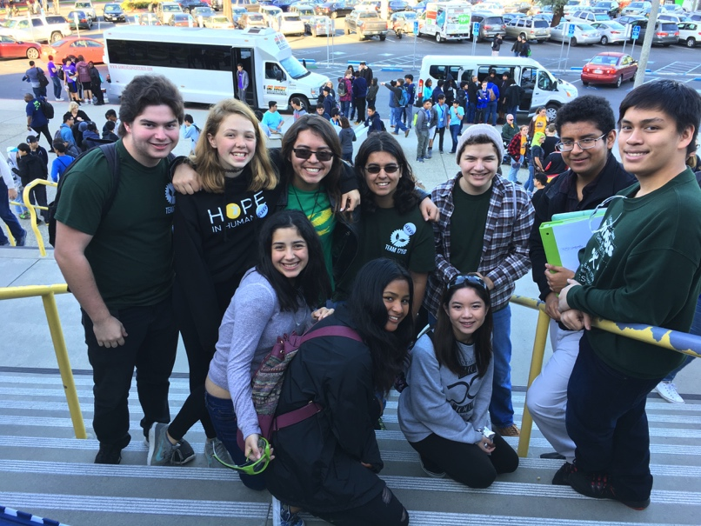
Who are we?
A legendary club that builds high-functional robots through teamwork and companionship
Notes:
Been around for ten years
Looking for members

Slide 3
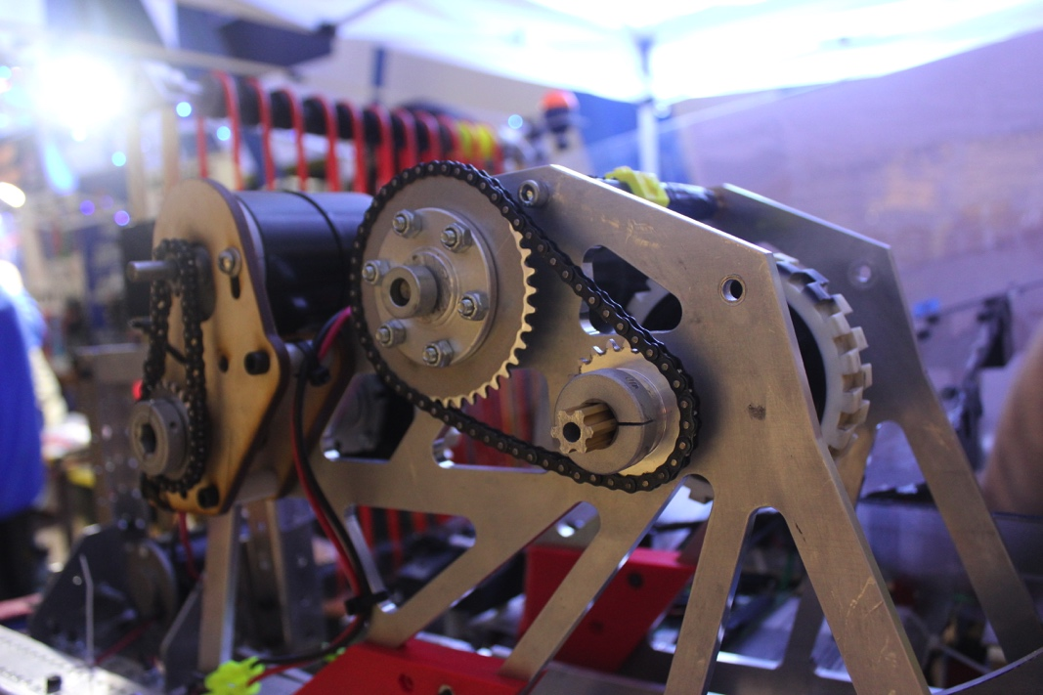
Who are we?
We build robots through many competitions and programs including:
VRC (VEX Robotics Competition)
FRC (FIRST Robotics Competition)
Drone Club
Computer Science Club
Notes:
Photo is FRC Competition
FRC open to people who have been in Robotics Club for one year

Slide 4
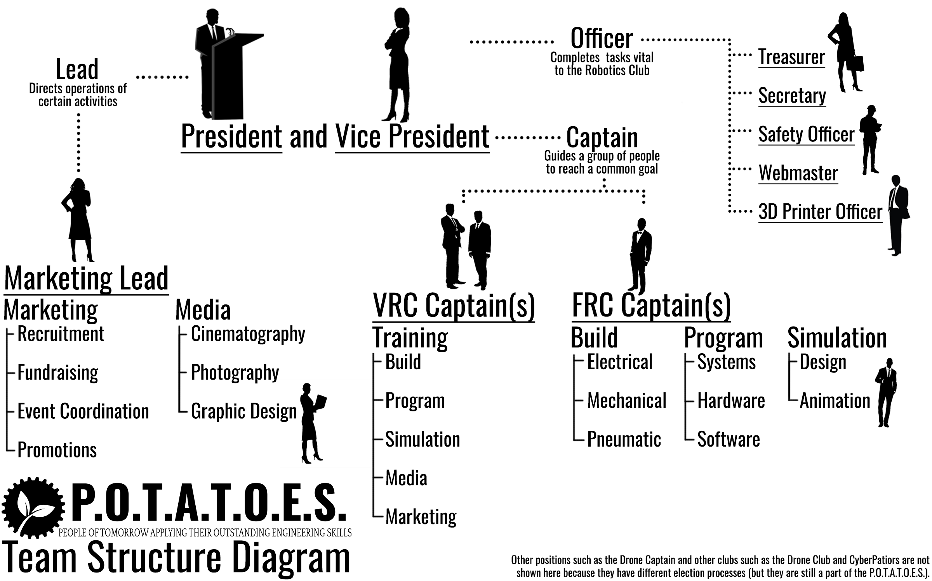

Slide 5
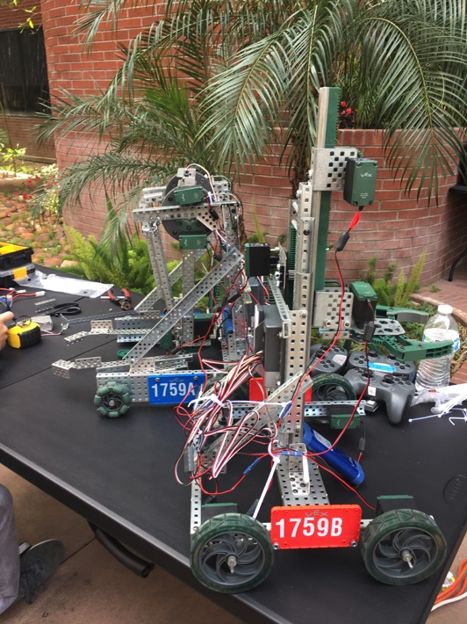
What is VRC?
Competition in which groups of 3-4 students fabricate a robot to accomplish a goal
What you will learn
Building
Programming
3D Modeling (Simulation)

Slide 6

Portion of the Official Trailer Video
https://www.youtube.com/watch?v=1Yo_mlR1VJU

Slide 7
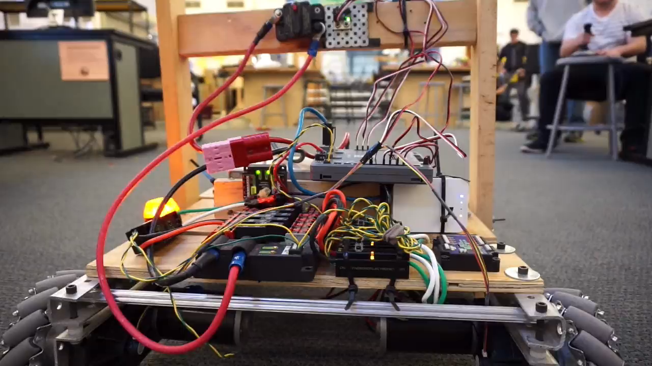
What is FRC?
About 10-30 people fabricate a large robot to accomplish a specific task
Skills that will be used
Building
Programming
3D Modeling (Simulation)
https://www.youtube.com/watch?v=1Yo_mlR1VJU
Notes:
Same skills you will use in VEX

Slide 8
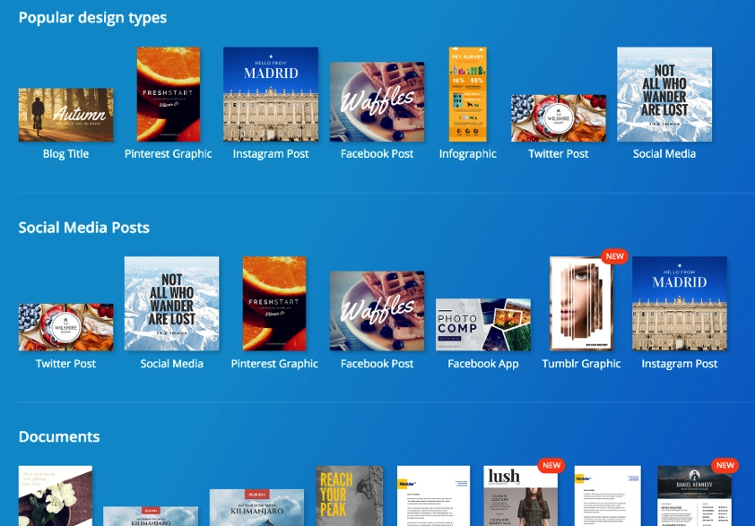
What is the Marketing Team?
Fundraising
Media Creation
Filmography
Photography
Art
Outreach
Social Media
Networking w/ other teams
Business
Website Design
Writing
Newsletter
Music

Slide 9
Perks
Scholarships
200 Scholarship Providers
$50 Million Available Scholarships
Internships
Higher chance of interning if you have experience
Experience
Prestige on college applications
Obtain professional advice from dedicated mentors
Notes:
Data from FRC competition alone

Slide 10
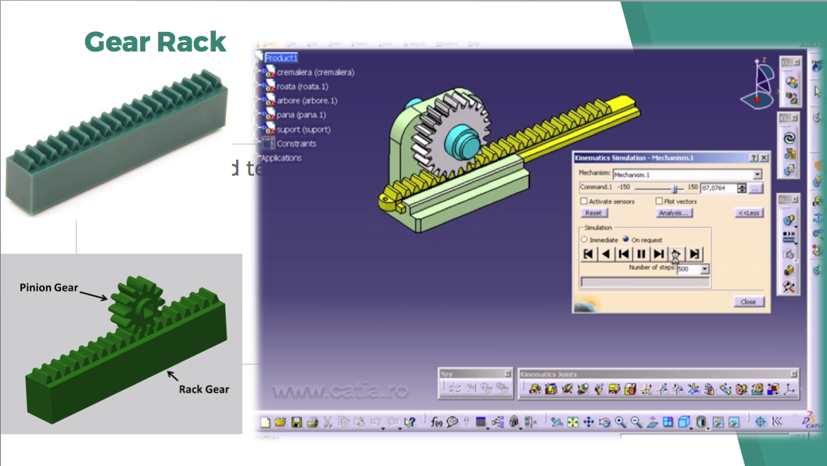
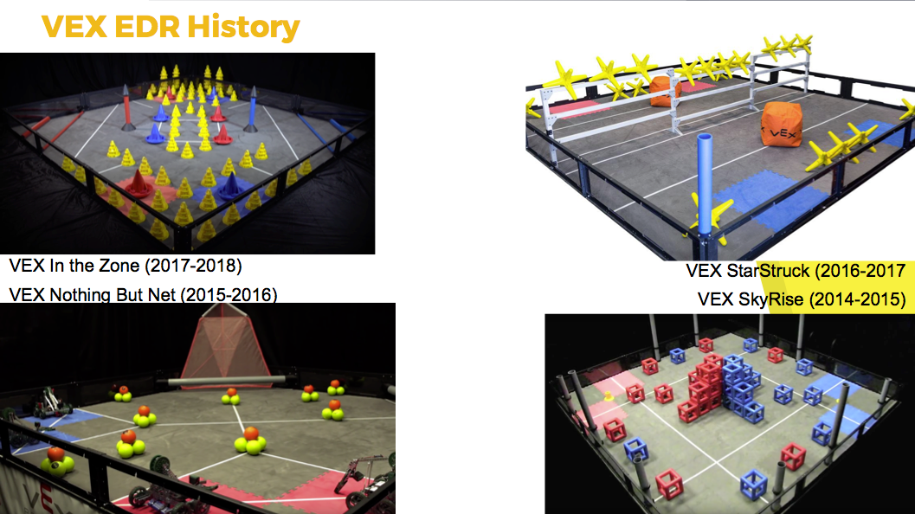

Preview
RobotC is a programming language that your robot will mindlessly obey
Create 3D Models by using Autodesk Inventor
Learn robotics easily with our comprehensive & interactive slides w/ Kahoot competitions
Notes:
Really hype everything up
don’t really need any outside studying

Slide 11
“On our own, we are marshmallows and dried spaghetti, but together we can become something bigger.”
- C.B. Cook

Slide 12
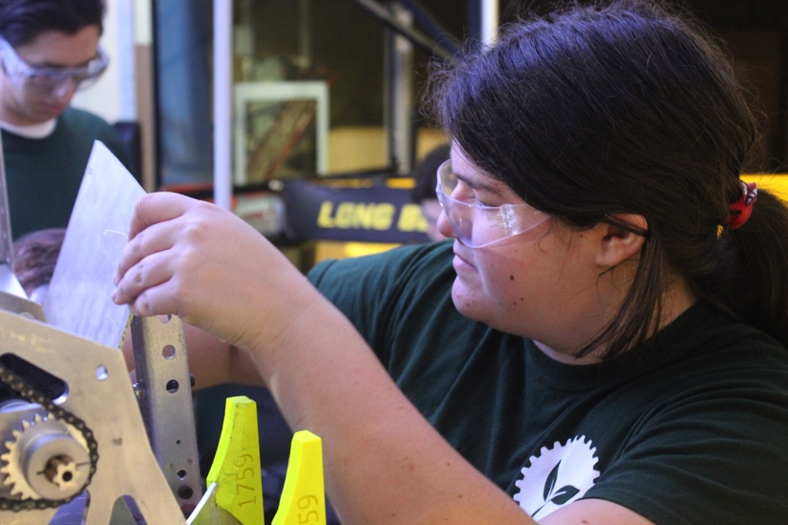
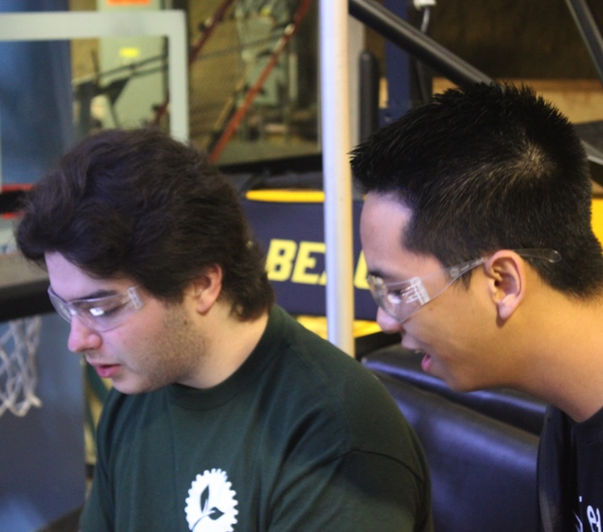
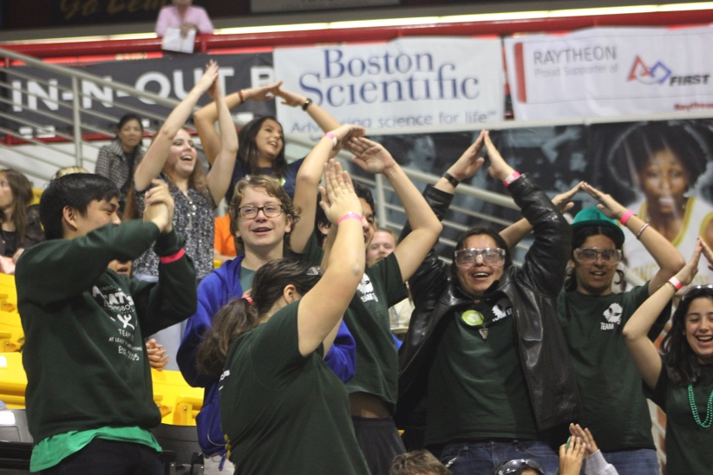
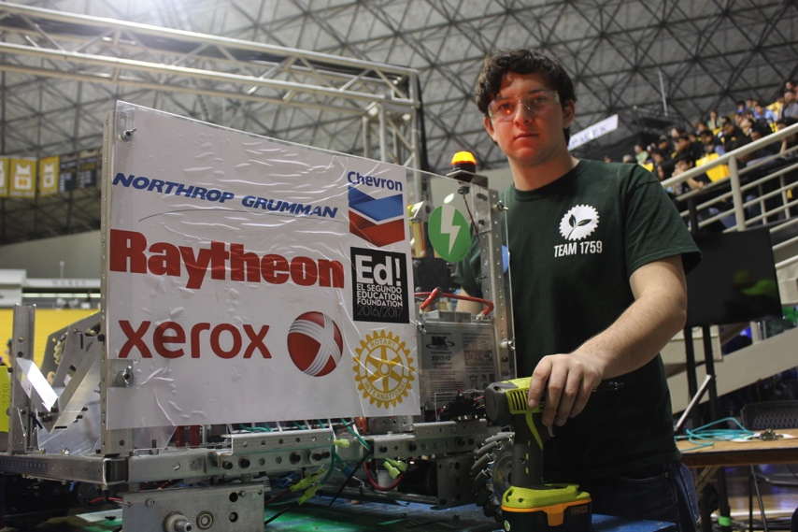

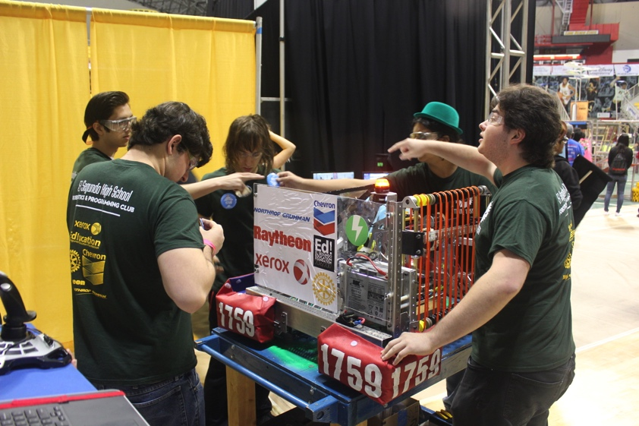
Join the vibrant E.S.H.S. Robotics community!

Slide 13
Starting September 7, Thursday

Slide 14
STARTING SEPTEMBER 7, THURSDAY
MEET US IN THE ENGINEERING LAB AT 4:00 PM
Notes:
Questions?

